Slide 1
Z. Gu
Embedded Systems with ARM Cortex-M Microcontrollers in Assembly Language and C
Chapter 3
ARM Instruction Set Architecture
Spring 2026
Acknowledgement: Lecture slides based on Embedded Systems with ARM Cortex-M Microcontrollers in Assembly Language and C, University of Maine https://web.eece.maine.edu/~zhu/book/

Slide 2
History

Slide 3




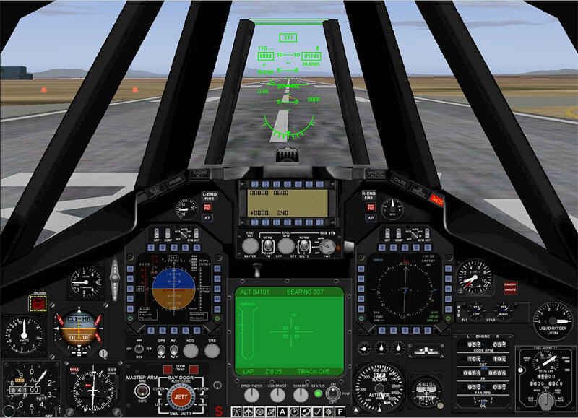

ARM Processors
ARM Cortex-A family:
Applications processors
Support OS and high-performance applications
Such as Smartphones, Smart TV
ARM Cortex-R family:
Real-time processors with high performance and high reliability
Support real-time processing and mission-critical control
ARM Cortex-M family:
Microcontroller
Cost-sensitive, support SoC

Slide 4
ARM Family

Slide 5
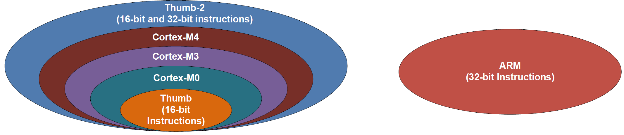
Instruction Sets
Instructions:
Encoded to binary machine code by assembler
Executed at runtime by hardware
Early 32-bit ARM vs Thumb/Thumb-2
Early ARM has larger power consumption and larger program size
16-bit Thumb, first used in ARM7TDMI processors in 1995
Thumb-2: a mix of 16-bit (high code density) and 32-bit (high performance) instructions
ARM Cortex-M:
Subset of Thumb-2

Slide 6
ARM Processors

Slide 7
Processor Registers
Fastest way to read and write
Registers are within the processor chip
Each register has 32 bits
ARM Cortex-M4 has
Register Bank: R0 – R15
R0-R12: 13 general-purpose registers
R13: Stack pointer (Shadow of MSP or PSP)
R14: Link register (LR)
R15: Program counter (PC)
Special registers
xPSR, BASEPRI, PRIMASK, etc
Register Bank
Special Registers

Slide 8
Processor Registers
Low Registers (R0 – R7)
Can be accessed by any instruction
High Register (R8 – R12)
Can only be accessed by some instructions
Stack Pointer (R13)
Cortex-M4 supports two stacks
Main SP (MSP) for privileged access (e.g. exception handler)
Process SP (PSP) for application access
Program Counter (R15)
Memory address of the current instruction
Register Bank
Special Registers

Slide 9
Processor Registers vs Peripheral Registers
ARM Cortex-M Core
ALU
Registers
Registers
Registers
Control Unit
GPIO B
GPIO A
UART1
SPI
ADC
Registers
Registers
Registers

Slide 10
Processor Registers vs Peripheral Registers
Processor can directly access processor registers
ADD r3,r1,r0 ; r3 = r1 + r0
Processor access peripheral registers via memory mapped I/O
Each peripheral register is assigned a fixed memory address at the chip design stage
Processor treats peripherals registers the same as data memory
Processor uses load/store instructions to read from/write to memory (to be covered in future lectures)

Slide 11
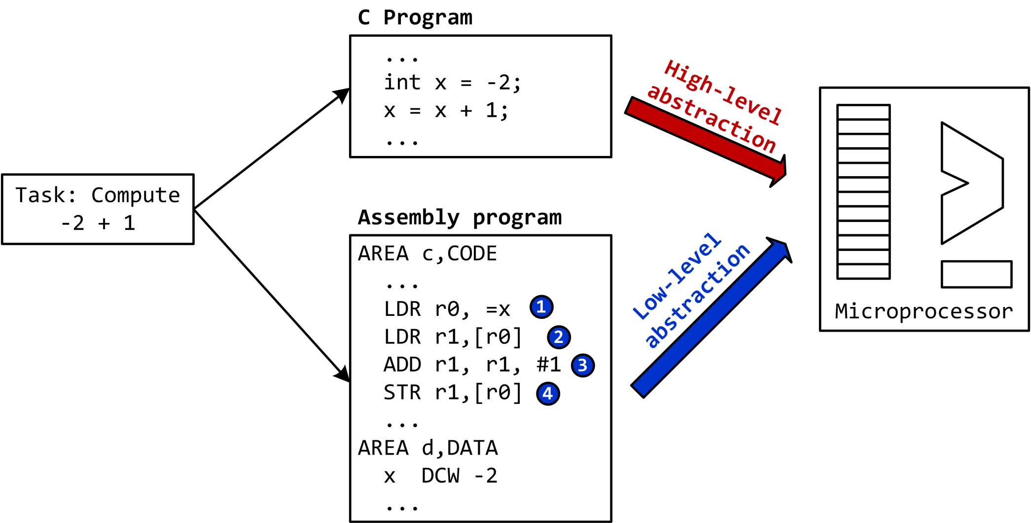
C vs Assembly

Slide 12
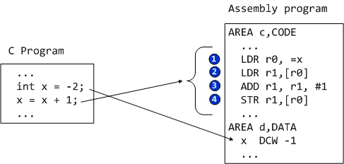
Load-Modify-Store
Translating C to assembly
Load values from memory into registers
Modify value by applying arithmetic operations
Store result from register to memory

Slide 13
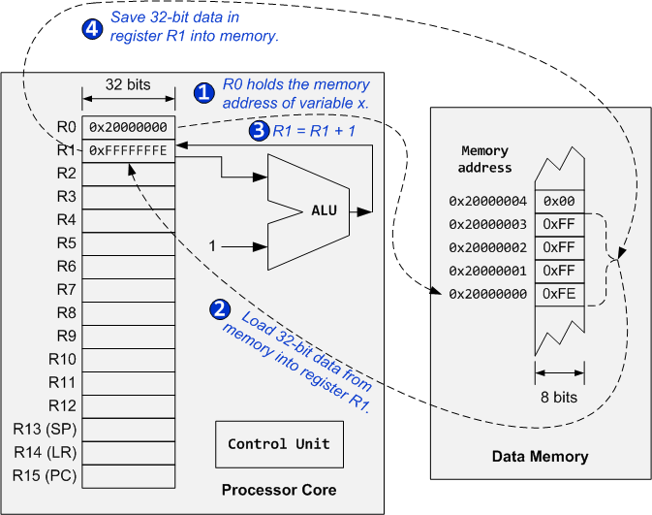
Load-Modify-Store

Slide 14
ARM Cortex-M4 Organization (STM32L4)
System-on-a-chip

Slide 15
Assembly Instructions
Arithmetic and logic
Add, Subtract, Multiply, Divide, Shift, Rotate
Data movement
Load, Store, Move
Compare and branch
Compare, Test, If-then, Branch, compare and branch on zero
Miscellaneous
Breakpoints, wait for events, interrupt enable/disable, data memory barrier, data synchronization barrier

Slide 16
Instruction Format: Labels
label mnemonic operand1, operand2, operand3 ; comments

Slide 17
Instruction Format: Labels
label mnemonic operand1, operand2, operand3 ; comments
Place marker, marking the memory address of the current instruction
Used by branch instructions to implement if-then or goto
Must be unique

Slide 18
Instruction Format: Mnemonic
label mnemonic operand1, operand2, operand3 ; comments
The name of the instruction
Operation to be performed by processor core

Slide 19
Instruction Format: Operands
label mnemonic operand1, operand2, operand3 ; comments
Operands
Registers
Constants (called immediate values)
Number of operands varies
No operands: DSB
One operand: BX LR
Two operands: CMP R1, R2
Three operands: ADD R1, R2, R3
Four operands: MLA R1, R2, R3, R4
Normally
operand1 is the destination register, and operand2 and operand3 are source operands.
operand2 is usually a register, and the first source operand
operand3 may be a register, an immediate number, a register shifted to a constant number of bits, or a register plus an offset (used for memory access).

Slide 20
Instruction Format: Comments
label mnemonic operand1, operand2, operand3 ; comments
Everything after the semicolon (;) is a comment
Explain programmers’ intentions or assumptions

Slide 21
ARM Instruction Format
label mnemonic operand1, operand2, operand3 ; comments
target ADD r0, r2, r3 ; r0 = r2 + r3
label
mnemonic
destination operand
1st source operand
2nd source operand
comment

Slide 22
ARM Instruction Format
label mnemonic operand1, operand2, operand3 ; comments
Examples: Variants of the ADD instruction
ADD r1, r2, r3 ; r1 = r2 + r3
ADD r1, r3 ; r1 = r1 + r3
ADD r1, r2, #4 ; r1 = r2 + 4
ADD r1, #15 ; r1 = r1 + 15

Slide 23
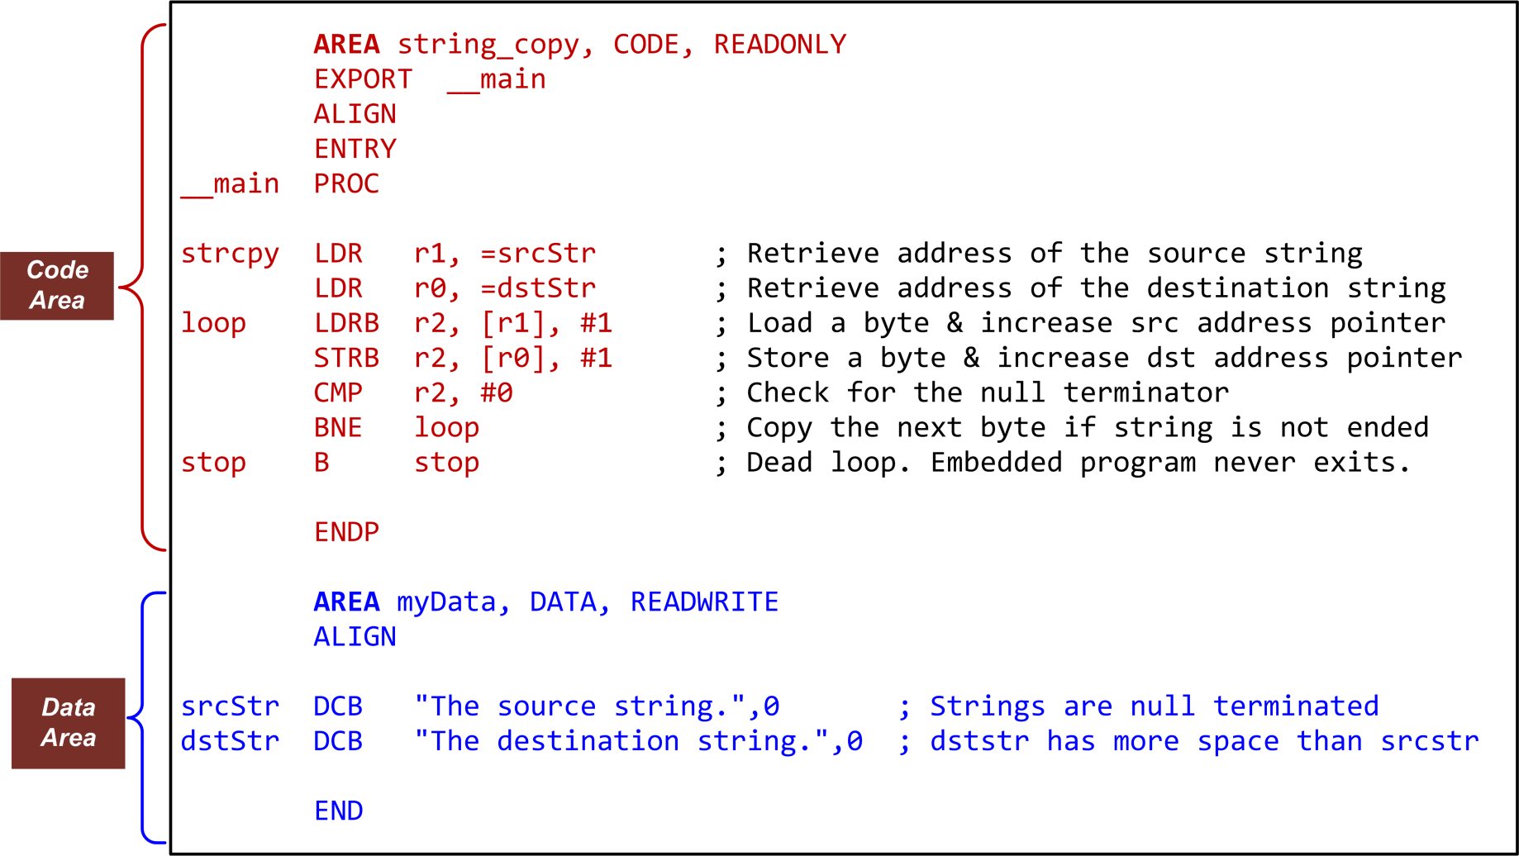
Example Assembly Program: Copying a String

Slide 24
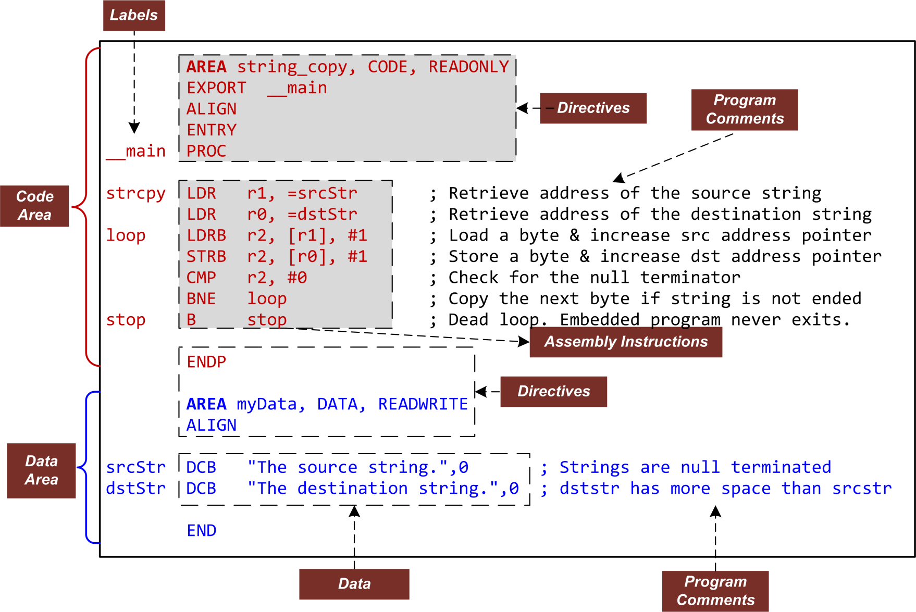
Example Assembly Program: Copying a String

Slide 25
Assembly Directives
Directives are NOT instructions. Instead, they are used to provide key information for assembly.
AREA | Make a new block of data or code
ENTRY | Declare an entry point where the program execution starts
ALIGN | Align data or code to a particular memory boundary
DCB | Allocate one or more bytes (8 bits) of data
DCW | Allocate one or more half-words (16 bits) of data
DCD | Allocate one or more words (32 bits) of data
SPACE | Allocate a zeroed block of memory with a particular size
FILL | Allocate a block of memory and fill with a given value.
EQU | Give a symbol name to a numeric constant
RN | Give a symbol name to a register
EXPORT | Declare a symbol and make it referable by other source files
IMPORT | Provide a symbol defined outside the current source file
INCLUDE/GET | Include a separate source file within the current source file
PROC | Declare the start of a procedure
ENDP | Designate the end of a procedure
END | Designate the end of a source file

Slide 26
Directive: AREA
AREA myData, DATA, READWRITE ; Define a data section Array DCD 1, 2, 3, 4, 5 ; Define an array with five integers AREA myCode, CODE, READONLY ; Define a code section EXPORT __main ; Make __main visible to the linker ENTRY ; Mark the entrance to the entire program __main PROC ; PROC marks the begin of a subroutine ... ; Assembly program starts here. ENDP ; Mark the end of a subroutine END ; Mark the end of a program
The AREA directive indicates to the assembler the start of a new data or code section.
Areas are the basic independent and indivisible unit processed by the linker.
Each area is identified by a name and areas within the same source file cannot share the same name.
An assembly program must have at least one code area.
By default, a code area can only be read (READONLY) and a data area may be read from and written to (READWRITE).

Slide 27
Directive: ENTRY
AREA myData, DATA, READWRITE ; Define a data section Array DCD 1, 2, 3, 4, 5 ; Define an array with five integers AREA myCode, CODE, READONLY ; Define a code section EXPORT __main ; Make __main visible to the linker ENTRY ; Mark the entrance to the entire program __main PROC ; PROC marks the begin of a subroutine ... ; Assembly program starts here. ENDP ; Mark the end of a subroutine END ; Mark the end of a program
The ENTRY directive marks the start point to execute a program.
There must be exactly one ENTRY directive in an application, no matter how many source files the application has.

Slide 28
Directive: END
AREA myData, DATA, READWRITE ; Define a data section Array DCD 1, 2, 3, 4, 5 ; Define an array with five integers AREA myCode, CODE, READONLY ; Define a code section EXPORT __main ; Make __main visible to the linker ENTRY ; Mark the entrance to the entire program __main PROC ; PROC marks the begin of a subroutine ... ; Assembly program starts here. ENDP ; Mark the end of a subroutine END ; Mark the end of a program
The END directive indicates the end of a source file.
Each assembly program must end with this directive.

Slide 29
Directive: PROC and ENDP
AREA myData, DATA, READWRITE ; Define a data section Array DCD 1, 2, 3, 4, 5 ; Define an array with five integers AREA myCode, CODE, READONLY ; Define a code section EXPORT __main ; Make __main visible to the linker ENTRY ; Mark the entrance to the entire program __main PROC ; PROC marks the begin of a subroutine ... ; Assembly program starts here. ENDP ; Mark the end of a subroutine END ; Mark the end of a program
PROC and ENDP are to mark the start and end of a function (also called subroutine or procedure).
A single source file can contain multiple subroutines, with each of them defined by a pair of PROC and ENDP.
PROC and ENDP cannot be nested. We cannot define a function within another function.

Slide 30
Directive: EXPORT and IMPORT
AREA myData, DATA, READWRITE ; Define a data section Array DCD 1, 2, 3, 4, 5 ; Define an array with five integers AREA myCode, CODE, READONLY ; Define a code section EXPORT __main ; Make __main visible to the linker ENTRY ; Mark the entrance to the entire program __main PROC ; PROC marks the begin of a subroutine ... ; Assembly program starts here. ENDP ; Mark the end of a subroutine END ; Mark the end of a program
The EXPORT declares a symbol and makes this symbol visible to the linker.
The IMPORT gives the assembler a symbol that is not defined locally in the current assembly file. The symbol must be defined in another file.
The IMPORT is similar to the “extern” keyword in C.

Slide 31
Directive: Defining Data
Directive | Description | Memory Space
DCB | Define Constant Byte | Reserve 8-bit values
DCW | Define Constant Half-word | Reserve 16-bit values
DCD | Define Constant Word | Reserve 32-bit values
DCQ | Define Constant | Reserve 64-bit values
DCFS | Define single-precision floating-point numbers | Reserve 32-bit values
DCFD | Define double-precision floating-point numbers | Reserve 64-bit values
SPACE | Defined Zeroed Bytes | Reserve a number of zeroed bytes
FILL | Defined Initialized Bytes | Reserve and fill each byte with a value

Slide 32
Directive: Defining Data
AREA myData, DATA, READWRITE
hello DCB "Hello World!",0 ; Allocate a string that is null-terminated
dollar DCB 2,10,0,200 ; Allocate integers ranging from -128 to 255
scores DCD 2,3.5,-0.8,4.0 ; Allocate 4 words containing decimal values
miles DCW 100,200,50,0 ; Allocate integers between –32768 and 65535
Pi_S DCFS 3.14 ; Allocate a single-precision floating number
Pi_D DCFD 3.14 ; Allocate a double-precision floating number
p SPACE 255 ; Allocate 255 bytes of zeroed memory space
f FILL 20,0xFF,1 ; Allocate 20 bytes and set each byte to 0xFF
binary DCB 2_01010101 ; Allocate a byte in binary
octal DCB 8_73 ; Allocate a byte in octal
char DCB ‘A’ ; Allocate a byte initialized to ASCII of ‘A’

Slide 33
Directive: EQU and RN
; Interrupt Number Definition (IRQn)
BusFault_IRQn EQU -11 ; Cortex-M3 Bus Fault Interrupt
SVCall_IRQn EQU -5 ; Cortex-M3 SV Call Interrupt
PendSV_IRQn EQU -2 ; Cortex-M3 Pend SV Interrupt
SysTick_IRQn EQU -1 ; Cortex-M3 System Tick Interrupt
Dividend RN 6 ; Defines dividend for register 6
Divisor RN 5 ; Defines divisor for register 5
The EQU directive associates a symbolic name to a numeric constant.
Similar to the use of #define in a C program, the EQU can be used to define a constant in an assembly code.
The RN directive gives a symbolic name to a specific register.

Slide 34
Directive: ALIGN
AREA example, CODE, ALIGN = 3 ; Memory address begins at a multiple of 8
ADD r0, r1, r2 ; Instructions start at a multiple of 8
AREA myData, DATA, ALIGN = 2 ; Address starts at a multiple of four
a DCB 0xFF ; The first byte of a 4-byte word
ALIGN 4, 3 ; Align to the last byte (3) of a word (4)
b DCB 0x33 ; Set the fourth byte of a 4-byte word
c DCB 0x44 ; Add a byte to make next data misaligned
ALIGN ; Force the next data to be aligned
d DCD 12345 ; Skip three bytes and store the word

Slide 35
Directive: INCLUDE or GET
INCLUDE constants.s ; Load Constant Definitions
AREA main, CODE, READONLY
EXPORT __main
ENTRY
__main PROC
...
ENDP
END
The INCLUDE or GET directive is to include an assembly source file within another source file.
It is useful to include constant symbols defined by using EQU and stored in a separate source file.

